Slide 1
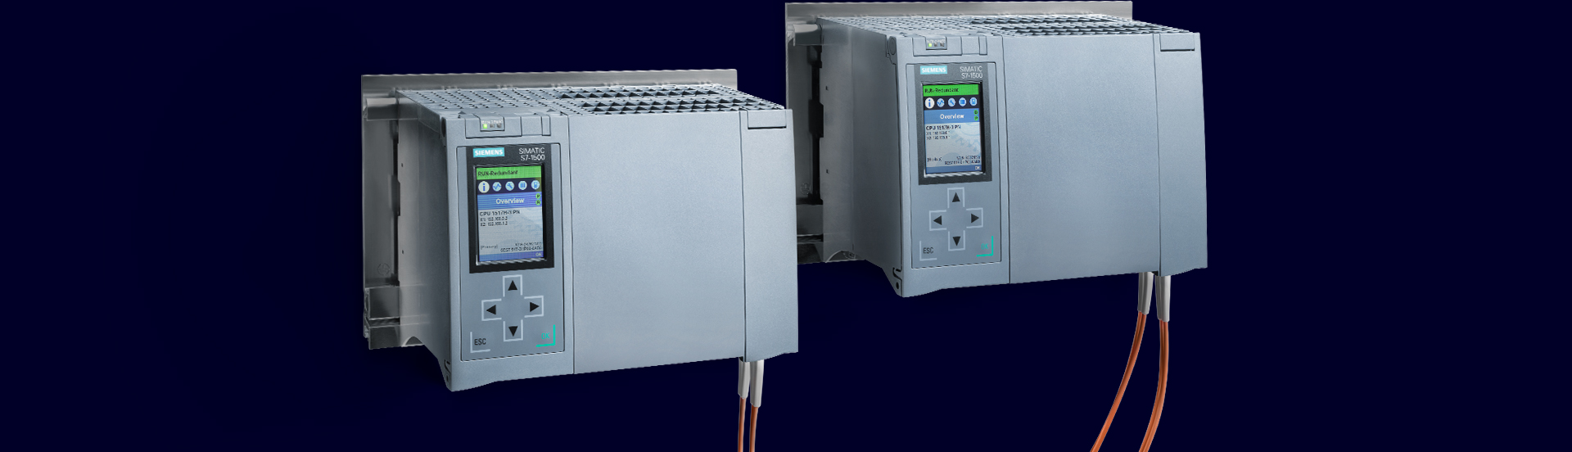
Redundant Systems
Network Configuration
Technical Details (Part 3)

Slide 2
SIMATIC S7-1500 Redundant Systems
Further technical slide sets
This document is part of a three-part set of slides
Part 1: Redundant Systems SIMATIC S7-1500 R/H
Part 2: PROFINET System Redundancy with S7-1500R/H and ET 200
Part 3: Network configuration with S7-1500 R/H
This document

Slide 3
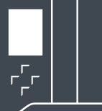

Network configuration with S7-1500R/H
Overview
S7-1500R
S7-1500H/HF
S7-1500H/HF
Controller
H-Sync
H-Sync
MRP Ring
MRP Ring
Line
Redundant MRP Ring
Redundant line
PROFINET
Topology
From FW V3.0
From FW V3.0
From FW V3.0
Additional
Topologies
MRP-Interconnection
MRP-Interconnection,
combined topology
MRP-Interconnection,
combined topology
IO-Devices
System
Redundancy¹⁾
S2
S1
S2
S1
R1
S2
S1
Via Y-Switch
1) Details: See slide set Part 2 – PROFINET System Redundancy with S7-1500R/H and ET 200SP

Slide 4
Configuration Examples
S7-1500R

Slide 5


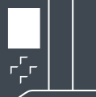



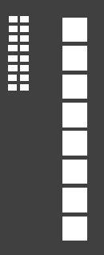

Configuration Examples S7-1500R
Ring Topology with MRP
Ring Topology
MRP ring is a prerequisite - the CPUs must be part of the ring
R-CPUs must be set as "MRP Automanager"
If the ring is interrupted, MRP reconfiguration is triggered
No devices allowed in the connection between the two CPUs
Recommendation: Max. 16 devices in the ring
Connecting S1 Devices via a Switch ¹⁾
Devices with more than two ports
(e.g. switches) must support H-Sync forwarding
Sync
MRP Ring
H-Sync Forwarding
must be supported
S1 Devices
connected via switch
1) Reason: S1 devices do not route the H-Sync telegrams during an MRP reconfiguration phase. This would lead to a high CPU cycle time if the segment was interrupted. See chapter "H-Sync Forwarding" in the system manual S7-1500R/H

Slide 6
Configuration Examples S7-1500R
Ring Topology – Supplemented with MRP Interconnection
Ring coupling via MRP interconnection
MRP interconnection switches allow the coupling of multiple MRP rings:
Ring on S7-1500R + up to 10 additional MRP rings
Thanks to redundant switch architecture, the coupled network remains functional even if one switch fails.
Can be used with the following SCALANCE switches:
XR500, XM400, XC200, XF204-2BA, XP200
The requirement of the " H-Sync Forwarding " function applies only to the devices that are found in the ring of R-CPUs. Reason: There are no H-Sync telegrams in the additional MRP rings.
Sync
MRP Ring
MRP Ring
No requirement for "H-sync forwarding" in coupled rings

Slide 7
Configuration Examples
S7-1500H with S2 Redundancy

Slide 8
Configuration example S7-1500H with S2 Redundancy
Example with ring topology
Ring topology with S2 Redundancy
H-CPUs must be set as "MRP Automanager"
If the ring is interrupted, MRP reconfiguration is triggered
H-Sync
MRP Ring
Behavior in case of ring interruption
Primary
Backup
H-Sync
MRP Ring

Slide 9
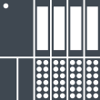
Configuration example S7-1500H with S2 Redundancy
Coupling of multiple MRP rings
Primary
Backup
Ring coupling via MRP interconnection
MRP interconnection switches allow the coupling of multiple MRP rings:
Ring on S7-1500H + up to 10 additional MRP rings
Thanks to redundant switch architecture, the coupled network remains functional even if one switch fails.
Up to 50 devices can be connected per ring → The total number of participants of an R/H CPU can also be achieved without spur lines.
Can be used with the following SCALANCE switches:
XR500, XM400, XC200, XF204-2BA, XP200
H-Sync
MRP Ring 1
MRP-i Switches.
MRP Ring 2
MRP Ring 3

Slide 10
Configuration example S7-1500H with S2 Redundancy
Example for Combined Topology – For example: Backbone-Ring
Connection to backbone ring
As of firmware V3.0, the ring no longer has to be routed through the CPUs
This allows connection to existing infrastructure
In the ring there is no restriction to 100MBit/s transmission speed
H-Sync
Backbone-Ring
1..10 Git/s
From FW V3.0 / V18

Slide 11
Configuration examples S7-1500H with S2 Redundancy
Example with line topology
Line topology with S2 Redundancy
MRP protocol is not used
If a distance in the ring is interrupted, IO data transmission takes place via the H-Sync line
Requires firmware version from V3.0 and TIA Portal from V18
H-Sync
Behavior in case of ring interruption
Primary
Backup
H-Sync
From FW V3.0 / V18

Slide 12
Configuration example S7-1500H without PN devices
Special case for operation without PROFINET devices
Operation without PROFINET devices
If no PROFINET devices (S1, S2, R1) are connected, the X1 interfaces of the CPUs from V3.0 no longer need to be connected
Examples: Exclusive communication via Open User Communication or Modbus/TCP (e.g. communication concentrator")
H-Sync
Required setup with firmware < V3.0
Primary
Backup
H-Sync
X1
X1
From FW V3.0 / V18

Slide 13
Configuration Examples
S7-1500H with R1 Redundancy
From firmware V3.0 and TIA Portal V18

Slide 14

Configuration examples S7-1500H with R1 Redundancy
Example with ring topology
Ring topology with R1 Redundancy
A separate ring is set up for each H-CPU
H-CPUs must be set as "MRP Automanager"
If a track in the ring is interrupted, MRP reconfiguration takes place
Separate networks – same (mirror-image) IP addresses can be used
MRP Ring
MRP Ring
From FW V3.0 / V18

Slide 15
Configuration examples S7-1500H with R1 Redundancy
Ring topology for S7-1500H – extended with MRP Interconnection
Redundant ring coupling via MRP interconnection
Redundant R1 rings can also be connected via MRP interconnection
Thanks to redundant switch architecture, the coupled network remains functional even if one switch fails.
Up to 50 devices can be connected per ring → The total number of participants of an H CPU can also be achieved without spur lines.
Can be used with the following SCALANCE switches:
XR500, XM400, XC200, XF204-2BA, XP200
MRP Ring
MRP Ring
MRP Ring
MRP Ring

Slide 16
Configuration examples S7-1500H with R1 Redundancy
Example for Combined Topology –For example: Backbone-Ring
Connection to separate ring
R1 rings do not have to be passed through the CPU
This enables connection to existing redundant network infrastructure
In the rings there is no restriction to 100MBit/s transmission speed
Ring 1
Backbone Rings
1..10 Git/s
Ring 2
From FW V3.0 / V18

Slide 17
Configuration examples S7-1500H with R1 Redundancy
Unsupported Topology - Single R1 Ring
This topology is not supported because the availability is unfavorable:
The probability of a fault in the ring is also twice as high as with an S2 setup due to twice the number of IMs

Slide 18

Configuration examples S7-1500H with R1 Redundancy
Example with line topology
Line topology with R1 Redundancy
Line topology is also supported for R1 setup
Up to 256 devices can be connected in this topology
The feeding of the PN line from different sides increases the availability in case of double line interruption
Single-sided feeding
If both lines are interrupted, devices behind them fail
X
X
Feeding from two sides
If both lines are interrupted, all devices can be reached
From FW V3.0 / V18

Slide 19



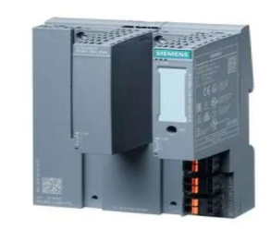
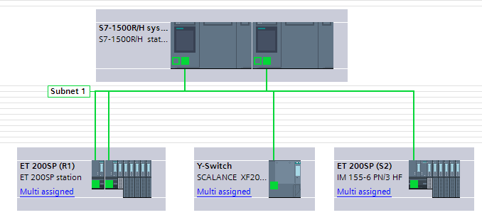
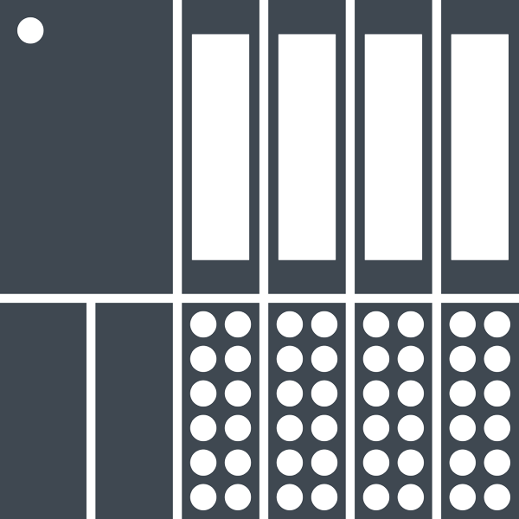




Configuration examples S7-1500H with R1 Redundancy
Combination of R1 and S1/S2 devices
R1 configurations can be extended with S2 or S1 devices using a Y-switch.
The prerequisite for this is the configuration in the TIA Portal on 1 subnet
Result: Unique IP addresses in
Network 1+2 are required
Primary PLC
Backup PLC
Network 1
Network 2
R1
Y-Switch
SCALANCE XF204-2BA DNA
6GK5204-0BA00-2YF2
R1 devices
S2
S1
Network 1+2
MRP Ring (optional)

Slide 20
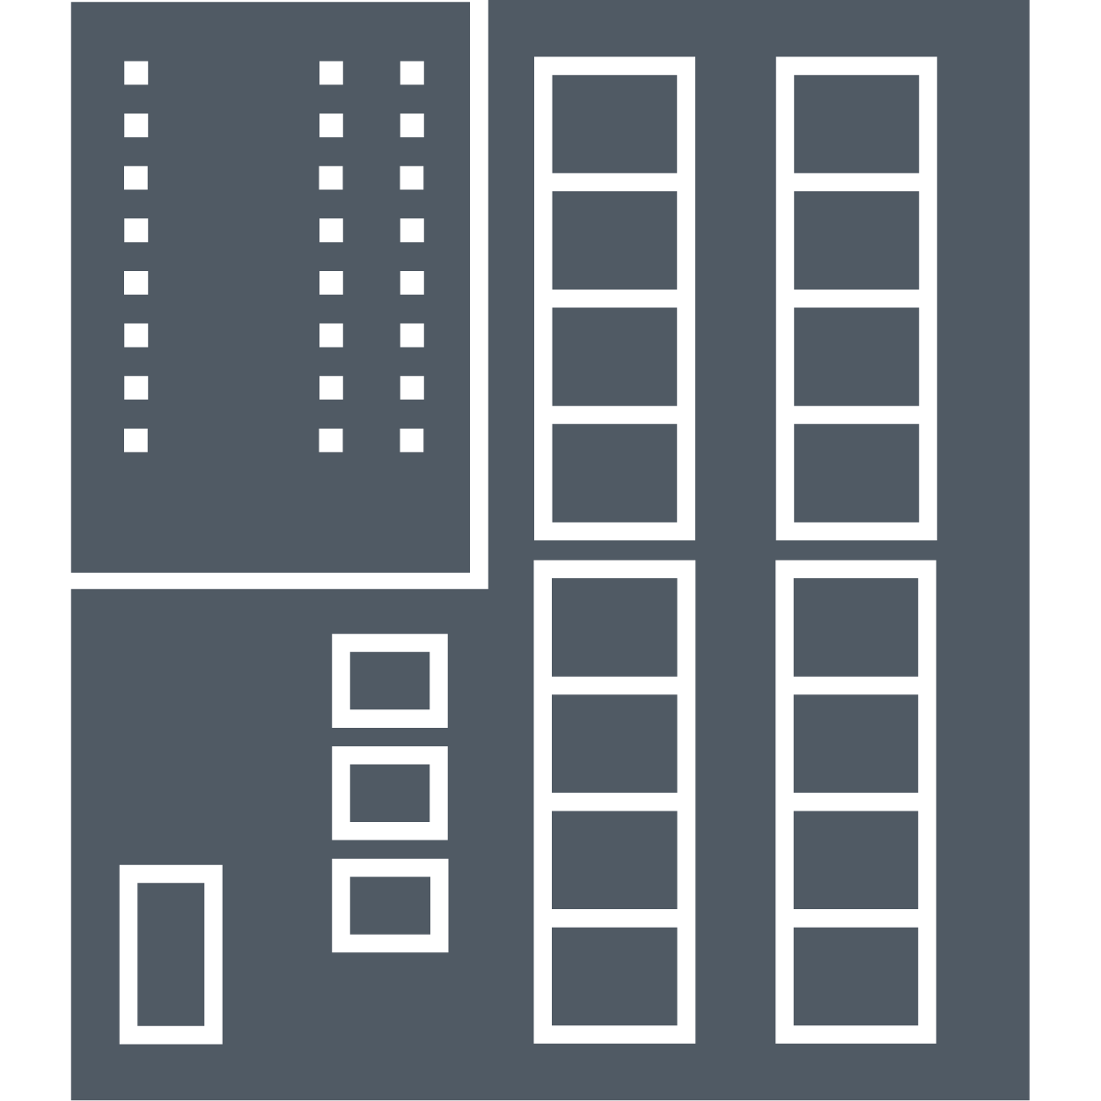
Configuration examples S7-1500H with R1 Redundancy
Combination of R1 and S1/S2 devices on ring structures
In order to connect the Y-switch to MRP rings, additional switches are required.
To increase availability, the Y-Switch can also be designed redundantly
"Redundant DNA".
In this case, an MRP ring must be used on the S1/S2 side.
Primary PLC
Backup PLC
Primary PLC
Backup PLC
R1
R1
Switch
Switch
Switch
Y-Switch
Y-Switch
S2
S1
Y-Switch
Y-Switch am MRP Ring
Redundanter Y-Switch am MRP Ring

Slide 21
Configuration examples S7-1500H with R1 Redundancy
IO devices that are connected to only one CPU
In some cases, it is sufficient if S1/S2 devices are connected to only one of the two CPUs.
Examples of this are switches that transmit diagnostic data to the controller via PROFINET.
Behavior in case of CPU 2 failure
CPU 1
CPU 2
CPU 1
CPU 2
Fault
IO-Device 3
IO-Device 3
Only connected to CPU 1
IO-Device 1
IO-Device 2
Only connected to CPU 2
IO-Device 1
IO-Device 2
Connected to both CPUs via R1
A failure of the connected CPU also leads to the failure of the IO device!

Slide 22
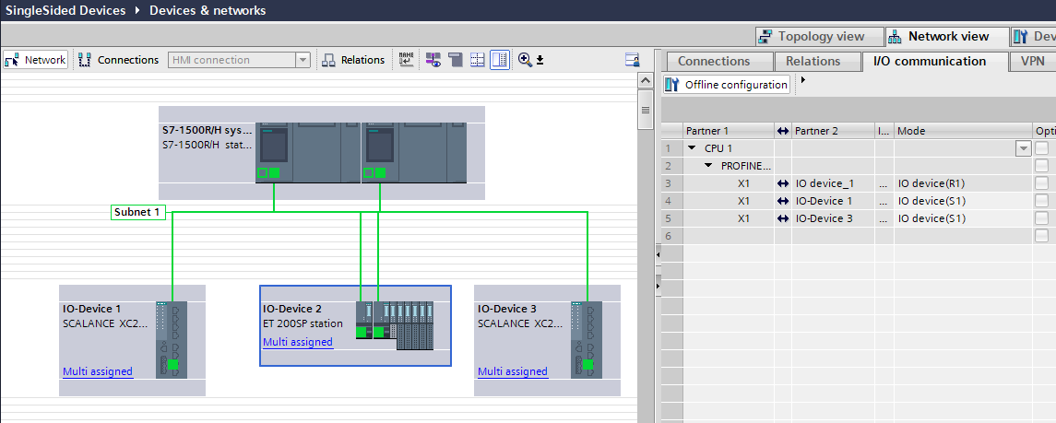
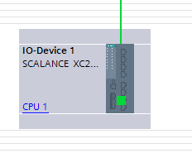
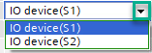
Configuration examples S7-1500H with R1 Redundancy
IO devices that are connected to only one CPU - Configuration
Even if devices are connected to only one CPU they must be mapped to both CPUs
Operating mode must be changed from "S2" to "S1" ¹⁾
Assignment to only
CPU 1 leads to an error during translation!
Assignment must be set to both CPUs
¹⁾ If the operating mode is not adjusted, the switch is detected as failed by the disconnected CPU and a corresponding bus error and alarm is generated.

Slide 23
System IP Address at
S2 ring and line structure

Slide 24

Network configuration with S7-1500 H
Use of System IP with MRP Ring
Initial Situation
Behavior in case of ring interruption
Primary
Primary
Fault
System IP
System IP
Reconfiguration of the MRP Ring
IO data continues to be transferred
Communication between HMI panel
and primary CPU is done via the
remaining route
→ HMI communication is maintained

Slide 25
Network configuration with S7-1500 H
Use of System IP with line topology
Initial Situation
Behavior in case of ring interruption
Primary
Primary
Sortie
System IP
System IP
IO data continues to be transferred
No more connection between HMI panel and primary CPU ¹⁾
→ Communication to HMI panel fails
1) Only IO data is forwarded via the H-Sync line but no IP communication
Recommendation: Use the device IP address of the CPUs for HMI communication

Slide 26
System IP Address at
R1 ring and line structure

Slide 27
Configuration examples S7-1500H with R1 Redundancy
Combination of R1 and HMI devices
Primary PLC
Backup PLC
R1 configurations can be extended with HMI devices using a Y-switch.
Network 1
Network 2
R1
Y-Switch
SCALANCE XF204-2BA DNA
6GK5204-0BA00-2YF2
R1 devices
HMI
MRP Ring (optional)

Slide 28
Configuration examples S7-1500H with R1 Redundancy
Combination of R1 and HMI devices
Primary PLC
Backup PLC
If the connection to the Y-Switch fails, the connected HMI device also fails in line topology.
Solution:
Use device IP addresses of the CPUs or build a ring structure
Network 1
Network 2
R1
Y-Switch
SCALANCE XF204-2BA DNA
6GK5204-0BA00-2YF2
R1 devices
HMI
MRP Ring (optional)

Slide 29
Connection of subordinate components

Slide 30

Network configuration with S7-1500 R/H
Connection of subordinate controllers
Option 1:
Connection as iDevice in switched S1 mode
Not bumpless
currently only possible via GSD
Primary
Backup
Option 3:
Open user communication between H-System and subordinate controller
→ With short interrupt
H-Sync
Open User Communication
S1
Terms:
Bumpless:
When switching the H-system, the outputs remain at the last value. The switching time is very short.
Option 2:
Via PN/PN Coupler
→ Bumpless switching
S2

Slide 31
Network configuration with S7-1500 R/H
Connection of PROFIBUS DP slaves
Option 1:
Connection as iDevice in switched S1 mode
Not bumpless
currently only possible via GSD
Primary
Backup
Option 3:
Open user communication between H-System and subordinate controller ¹⁾
→ With short interrupt
H-Sync
Open User Communication
S1
PROFIBUS
Option 2:
Via PN/PN Coupler
→ Bumpless switching
S2
PROFIBUS
PROFIBUS
Note: IE/PB Link and IE/PB LINK HA are currently not supported

Slide 32
R1 network configuration with S7-1500 H
Connection of subordinate controllers
Primary PLC
Backup PLC
Option 3:
Open user communication between H-System and subordinate controller ¹⁾
→ With short interrupt
Network 1
Network 2
Option 2:
About PN/PN Coupler
→ Bumpless switching
R1
S1
S2
Y-Switch
Option 1: Connection as iDevice in switched S1 mode
Not bumpless / only via GSD

Slide 33
R1 network configuration with S7-1500 H
Connection of PROFIBUS DP slaves
Primary PLC
Backup PLC
Option 3:
Open user communication between H-System and subordinate controller ¹⁾
→ With short interrupt
Network 1
Network 2
Option 2:
Via PN/PN Coupler
→ Bumpless switching
R1
S1
S2
Y-Switch
Option 1: Connection as iDevice in switched S1 mode
Not bumpless / only via GSD
PROFIBUS
PROFIBUS
PROFIBUS

Slide 34
Disclaimer
© Siemens 2022
Changes and errors excepted. The information in this document contains only general descriptions or performance characteristics, which do not always apply in the form described in the specific application or which may change due to further development of the products. The desired performance characteristics are only binding if they are expressly agreed upon conclusion of the contract.
All product names may be trademarks or other rights of Siemens AG, its affiliates or third parties, the use of which by third parties for their own purposes may infringe the rights of their respective owners.

Slide 35
Contact
Publisher: Siemens 2022

